Slide 1
Implementation of Tic-Tac-Toe Game
using
Q-learning Algorithm
By
Group 2

Slide 2
Group Members
Group Member | Roll No
Marasani Jayasurya | AM.EN.U4AIE20048
Samudrala Yashwanth | AM.EN.U4AIE20063
Yerramreddy Dhanvanth Reddy | AM.EN.U4AIE20077

Slide 3
Contents
Introduction
Q-Learning Algorithm
Problem Statement
Implementation of Tic-Tac-Toe
Results and Analysis
Advantages and Disadvantages
Challenges
Conclusion

Slide 4
Introduction
Tic-Tac-Toe is a classic game played on a 3x3 grid, where players take turns marking X or O in an attempt to form a line of three symbols. In this project, we aim to implement an AI agent that can play Tic-Tac-Toe using the Q-learning algorithm.
By applying Q-learning, an algorithm from the field of reinforcement learning, the AI agent can learn to make intelligent decisions based on the current state of the game board. It learns through interactions with the game environment and updates its knowledge by assigning rewards and penalties based on the game outcomes.

Slide 5
Introduction(contd.)
The implementation involves representing the game board as a 3x3 grid and initializing a Q-table to store action-value estimates for each state-action pair. The agent balances exploration and exploitation, gradually favoring exploitation as it learns.
Through training, the agent aims to converge to an optimal policy, enabling it to make strategic moves and play the game effectively.The outcome is an AI agent capable of playing Tic-Tac-Toe intelligently, providing an engaging and challenging experience for human players.

Slide 6
Q-learning algorithm
Q-learning is a reinforcement learning algorithm that is widely used for solving sequential decision-making problems. It is a model-free,off-policy algorithm that enables an agent to learn the optimal action-selection policy by interacting with the environment.
Q(s, a) = (1 - α) * Q(s, a) + α * (r + γ * max(Q(s', a')))

Slide 7
Q-learning algorithm
The Q-learning algorithm follows an iterative process, where the agent takes actions in the environment, observes the rewards and next states, and updates the Q-values accordingly. This process continues until the agent converges to an optimal policy.
Steps:
Initialize Q-values for all state-action pairs arbitrarily or to some initial values.
Repeat the following steps:
a. Choose an action a based on the current state s using a policy (e.g., ε-greedy policy).
b. Take action a, observe the immediate reward r, and the next state s'.
c. Update the Q-value using the Q-learning update formula.
d. Set the current state s to the next state s'.
e. Repeat until the termination condition is met (e.g., a maximum number of iterations).

Slide 8
Problem Statement
The objective of this project is to develop an AI agent capable of playing the game of Tic-Tac-Toe using reinforcement learning (Q-learning). The agent should learn to make intelligent decisions in order to win or draw against human opponents.

Slide 9
Implementation Of Tic-Tac-Toe
The steps involved in implementing a Tic-Tac-Toe game using Q-learning:
State Representation: Represent the game board as a 3x3 grid with empty, X, or O values.
Action Space: Define the available actions for the agent, which are placing X or O in any empty cell.
Q-Table Initialization: Create a Q-table to store the action-value estimates, initialized with zeros or random values.
Exploration-Exploitation Tradeoff: Balance exploration (trying new actions) and exploitation (choosing actions based on learned knowledge) using strategies like epsilon-greedy.

Slide 10
Implementation(contd.)
Learning Process: Interact with the environment, updating Q-values based on observed experiences using the Q-learning update rule.
Training Process: Continue interacting with the environment and updating Q-values until convergence or a predefined stopping criterion.
Policy Extraction: Use the learned Q-values to determine the best action in a given state, selecting the action with the highest Q-value.
By applying Q-learning to Tic-Tac-Toe, the agent can learn an optimal strategy for playing the game by maximizing expected cumulative rewards.

Slide 11
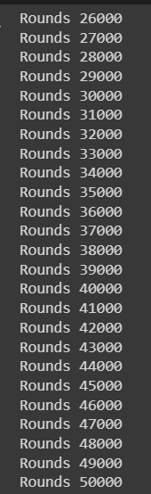
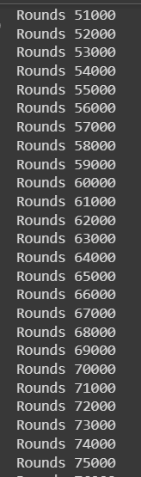
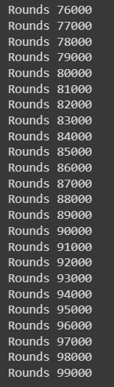
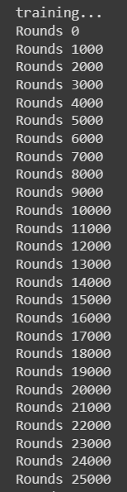
Results and Analysis

Slide 12
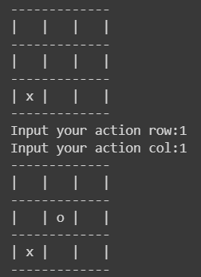
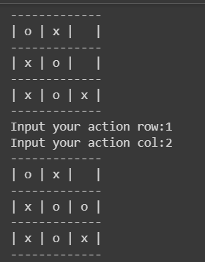
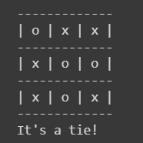
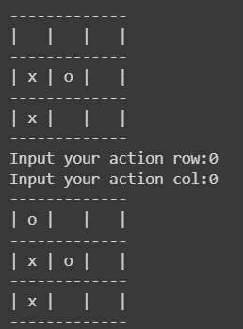
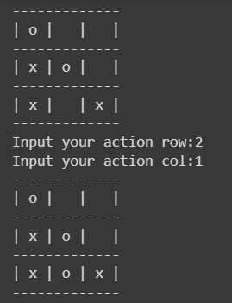

Slide 13
Advantages of Q-Learning Algorithm
Model-Free Learning
Off-Policy Learning
Optimal Policy Convergence
Generalization
Handles Continuous State and Action Spaces
Simple Implementation
Well-Studied and Widely Used

Slide 14
Disadvantages of Q-Learning Algorithm
Slow Convergence
Curse of Dimensionality
Exploration-Exploitation Dilemma
Hyperparameter Sensitivity
Knowledge Representation
Delayed Rewards
Need for Initial Exploration
Sample Efficiency

Slide 15
Conclusion
In conclusion, the implementation of Tic-Tac-Toe using Q-learning is a fascinating example of how AI can be used to solve simple games. While there are limitations to this approach, the success of the AI player in learning to play the game at an expert level is impressive.
This research opens up new possibilities for using AI to solve more complex games and problems. It also highlights the importance of designing algorithms that can learn from their own experiences and adapt to new situations.

